Slide 1

January 2025
Trademark and Brand Protection
Year in Review

Slide 2


Introductions
Carrie Barbee
  Partner
  Los Angeles
310 777 3735​
cbarbee@ktslaw.com
Olivia Poppens-Schultz
Senior Associate ​
Los Angeles​
310 777 3729​
opoppens@ktlsaw.com

Slide 3

Agenda
  Recent Updates in Trademark Law
  Use in Commerce & Distinctiveness of Word Marks
  Functionality & Distinctiveness of Trade Dress
  Proving Dilution of Trade Dress
  Court Intervention in the Trademark Application Process
  Counterfeiting Liability
  Cybersquatting Liability
  Trademark Damages
  Defenses to Trademark Claims

Slide 4
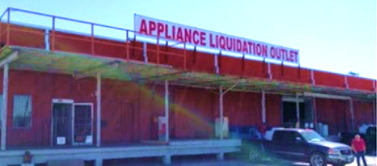

Use in Commerce & Distinctiveness
Appliance Liquidation Outlet, L.L.C. v. Axis Supply Corp., 105 F.4th 362 (5th Cir. 2024)
Appliance Liquidation Outlet, L.L.C. ("ALO") sued junior user Axis Supply Corp. ("Axis") after Axis opened a store called "Appliance Liquidation."
ALO tried to claim trademark rights in both APPLIANCE LIQUIDATION and APPLIANCE LIQUIDATION OUTLET.
District Court found in favor of ALO as to infringement of both marks. 5th Circuit reversed as to validity of the APPLIANCE LIQUIDATION mark.

Slide 5
Use in Commerce & Distinctiveness
Appliance Liquidation Outlet, L.L.C. v. Axis Supply Corp., 105 F.4th 362 (5th Cir. 2024)
To qualify as a trademark, a word, phrase, or symbol must identify and distinguish the goods or services of one seller from those of others.
No Presumption of Validity: "Appliance Liquidation" was not registered and therefore not presumptively valid.
Insufficient Evidence of Validity: The record did not support a finding that “Appliance Liquidation” was a source identifier and therefor a valid mark.
  Testimony of one ALO employee that she tells people she works at "Appliance Liquidation," and that she answers the phone using "Appliance Liquidation Outlet" and "Appliance Liquidation" interchangeably.
  Testimony from one of ALO's owners that advertisements would either say "Appliance Liquidation Outlet" or "Appliance Liquidation."
  No evidence that ALO used "Appliance Liquidation" intentionally to identify its store.

Slide 6
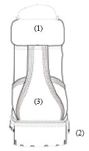
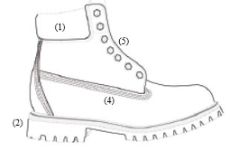
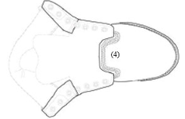
Functionality & Distinctiveness
TBL Licensing, LLC v. Katherine Vidal, Director of the USPTO, 98 F.4th 500 (4th Cir. 2024)
TLB Licensing, LLC ("TLB"), maker of Timberland boots, filed an application to register the trade dress in a certain subset of design elements of the boots.
In its application, TLB provided a detailed written description and drawings of the specific design elements it sought to register.
Product designs do not receive trademark protection if the design as-a-whole is functional, or if it lacks distinctiveness as a source-identifier.

Slide 7
Functionality & Distinctiveness
TBL Licensing, LLC v. Katherine Vidal, Director of the USPTO, 98 F.4th 500 (4th Cir. 2024)
USPTO refused registration based on lack of distinctiveness; District Court upheld the refusal to register on both distinctiveness and functionality grounds.
4th Circuit upheld the District Court's findings of functionality and distinctiveness.
Functionality – The District Court did not err in finding that the boot design was functional based on the following two (of four) functionality factors.
  At least one utility patent disclosed each feature of the boot design TBL sought to register.
  Numerous advertisements touted functional benefits of the design elements.
Distinctiveness of Identified Elements – The boot as-a-whole is not the focus; the specific features TBL applied to register are what need to be proven distinctive.

Slide 8
Functionality & Distinctiveness
TBL Licensing, LLC v. Katherine Vidal, Director of the USPTO, 98 F.4th 500 (4th Cir. 2024)
Distinctiveness Factors:
  Advertising Expenditures: Despite $81 million in ad spend, ads pointed to boots generally; did not tell consumers to "look for" any specific features Timberland sought to register.
  Sales: Despite averaging almost $100M in sales per year, no evidence showing why consumers bought the boots.
  Unsolicited Media Coverage: Examples featured boots as-a-whole and did not highlight specific features of boot design.
  Attempts to Plagiarize: Existence of numerous look-alikes did not show competitors intended to trick consumers into thinking their boots were Timberlands.
  Continuous & Exclusive Use: Existence of numerous look-alikes actually undermined TBL because it showed lack of substantially exclusive use.

Slide 9
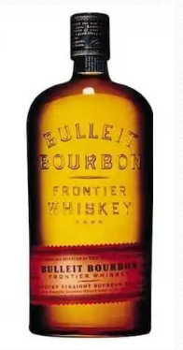
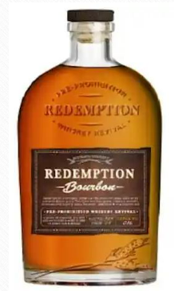
Proving Dilution of Trade Dress
Diageo N. Am. V. W.J. Deutsch & Sons Ltd., No. 22-2106, 2024 WL 2712636 (2nd Cir. May 28, 2024)
Diageo North America ("Diageo"), owner of Bulleit brand whiskey, filed suit against Deutsch & Sons ("Deutsch"), owner of Redemption brand whiskey, for trade dress infringement and dilution.
Jury held against Diageo on its infringement claim but in favor of Diageo on its federal and state law dilution claims.
As to federal dilution, jury found the Bulleit trade dress was famous.
As to NY state dilution, jury found Redemption trade dress was "substantially similar" to the Bulleit trade dress.

Slide 10
Proving Dilution of Trade Dress
Diageo N. Am. V. W.J. Deutsch & Sons Ltd., No. 22-2106, 2024 WL 2712636 (2nd Cir. May 28, 2024)
Federal Dilution/Fame Evidence:
  Diageo marketed Bulleit trade dress since 1999.
  From 2011-2016, Diageo spent $56 million on advertising and promotion.
  From 2005-2016, Bulleit packaging was featured in at least 16 TV shows and 4 movies.
  Starting in 2012, Bulleit was feature in GQ and Esquire magazines.
  Diageo made over $100 million in sales of Bulleit each year.
  Bulleit trade was registered with U.S.P.T.O. in 2006.
NY State Dilution/Substantial Similarity Evidence: Images of the bottles side-by-side on store shelves, a design brief revised by Deutsch with directions to propose a new bottle shape similar to the Bulleit design, and consumer market research statements.

Slide 11
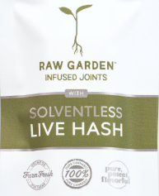
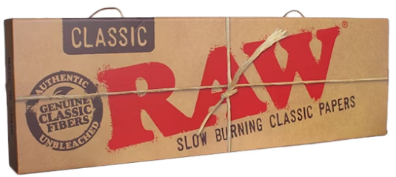
Court Intervention in TM Application Process
BBK Tobacco & Foods LLP v. Central Agriculture Inc., 97 F.4th 668 (9th Cir. 2024)
BBK Tobacco & Foods LLP ("BBK") sold RAW branded smoking related products. Central Coast Agriculture, Inc. ("Central Coast") sold RAW GARDEN cannabis products.
BBK sued Central Coast for trademark infringement and sought to invalidate Central Coast's trademark applications.
District Court granted summary judgment in favor of BBK ordering invalidation of Central Coast's trademark applications under 15 U.S.C. § 1119 for lack of bona fide intent to use.
Central Coast appealed, arguing the District Court lacked jurisdiction to void trademark applications.

Slide 12
Court Intervention in TM Application Process
BBK Tobacco & Foods LLP v. Central Agriculture Inc., 97 F.4th 668 (9th Cir. 2024)
"In any action involving a registered mark the court may determine the right to registration, order the cancelation of registrations, in whole or in part, restore canceled registrations, and otherwise rectify the register with respect to the registrations of any party to the action." 15 U.S.C. § 1119
"A person who has a bona fide intention, under circumstances showing the good faith of such person, to use a trademark in commerce may request registration of its trademark on the principal register[.]" 15 U.S.C. § 1051(b)(1).
Majority Opinion: The plain language of § 1119 grants a district court jurisdiction to consider challenges to trademark applications of a party if the action involves a registered trademark, including lack of bona fide intent to use a mark.
Dissent: The authority to determine the "right to registration" referenced in § 1119 is limited to the court's authority to cancel already issued registrations; not pending applications – which are solely within the purview of the U.S.P.T.O. under the statute.

Slide 13





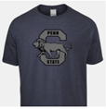
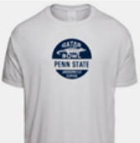
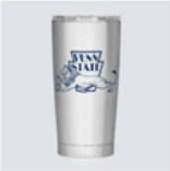
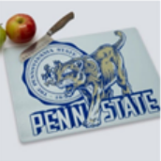
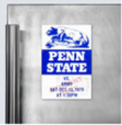
Liability for Counterfeiting
Pennsylvania State University v. Vintage Brand, LLC, 715 F.Supp.3d 602 (M.D. Penn. Feb. 6, 2024)
Pennsylvania State University ("Penn State") owns rights to a number of marks that it licenses to others to use in connection with merchandise via licensing program operated by the Collegiate Licensing Company.
Vintage Brands, LLC ("Vintage Brands") sold vintage-inspired merchandise featuring logos and images of universities and professional sports teams, including Penn State. All Vintage Brands merchandise contained the Vintage Brands mark on the packaging.

Slide 14
Liability for Counterfeiting
Pennsylvania State University v. Vintage Brand, LLC, 715 F.Supp.3d 602 (M.D. Penn. Feb. 6, 2024)
Vintage Brands MSJ: Vintage Brand's images not substantially indistinguishable from Penn State's marks because Vintage Brand's own mark is displayed on its website and packaging.
Statutory Definition of Counterfeit: "[A] spurious mark which is identical with, or substantially indistinguishable from, a registered mark." 15 U.S.C. § 1127.
Judicial Definition of "Spurious": "Fake" or "deceptively suggesting erroneous origin.
District Court's Ruling: No evidence that Vintage Brand's use of Penn State Marks caused confusion as to origin of goods sold by Vintage Brands:
  It is nearly impossible to think that any rational consumer would expect a university to produce its own merchandise and therefore be confused as to the origin of Vintage Brands' goods; and
  The Vintage Brand's mark appears on the top of its webpage and prominently on all packaging of Vintage Brand's goods, making it implausible that a consumer would be confused as to the origin (as opposed to sponsorship) of those goods.

Slide 15
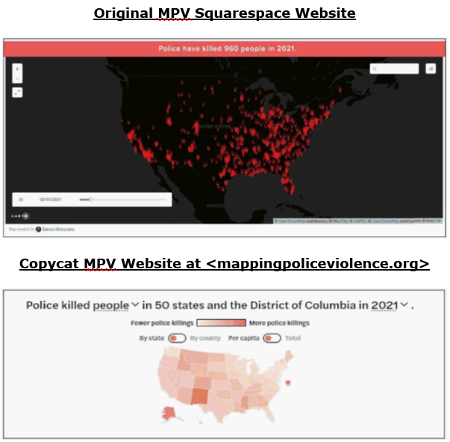
Cybersquatting Liability
We the Protesters, Inc. v. Sinyangwe, No. 22 CIV. 9565, 2024 WL 1195417 (S.D.N.Y. Mar. 20, 2024)
Non-profit We the Protestors, Inc. d/b/a Campaign Zero was social justice organization with the objective of eliminating police violence.
Samuel Sinyangwe created a project and website called Mapping Police Violence ("MPV") in late 2014 and was a co-founder of Campaign Zero.
Sinyangwe launched the original MPV website using Squarespace on March 1, 2015, and a fellow co-founder of Campaign Zero purchased the domain <mappingpoliceviolence.org> domain the same day.
Sinyangwe parted ways with Campaign Zero in September 2021, and Campaign Zero unsuccessfully tried to take control of the original MPV website, eventually launching its own copycat site.

Slide 16
Cybersquatting Liability
We the Protesters, Inc. v. Sinyangwe, No. 22 CIV. 9565, 2024 WL 1195417 (S.D.N.Y. Mar. 20, 2024)
Campaign Zero filed suit against Sinyangwe, who counterclaimed for cyberpiracy under the Anti-Cybersquatting Consumer Protection Act (“ACPA”), 15 U.S.C. § 1125.
ACPA Elements: (1) claimant's mark was distinctive at the time the domain name was registered; (2) the infringing domain name is identical or confusingly similar to the claimant's mark; and (3) the infringer has a bad faith intent to profit from the mark.
Campaign Zero MTD: Campaign Zero moved to dismiss on the ground that MAPPING POLICE VIOLENCE mark was not distinctive at the time the mappingpoliceviolence.org domain was registered in March 2015.
Court Ruling: Under the ACPA, the "time the domain name was registered" refers not only to the initial registration of a domain, but also to domain name renewals. Campaign Zero renewed the domain in 2023, well after the MAPPING POLICE VIOLENCE mark allegedly acquired distinctiveness.

Slide 17


Disgorgement of Profits
Dewberry Eng’rs Inc. v. Dewberry Grp., 77 F.4th 265 (4th Cir. 2023), cert. granted, 144 S. Ct. 2681 (2024)
Is the equitable remedy of an accounting of profits subject to guardrails?
We shall see. Differing opinion on the appropriate question for disgorgement of profits:
    Defendant: “[w]hether an award of the ‘defendant’s profits’ under [Section 35(a) of] the Lanham Act, can include an order for the defendant to disgorge the distinct profits of legally separate non-party corporate affiliates,”
    Plaintiff: “[w]hether a district court’s discretion under the Lanham Act permits using the financial statements of ‘non-arm's length’ affiliates to adjust a disgorgement award against a trademark infringer, and only that infringer, when the infringer has claimed $0 in profits.”

Slide 18
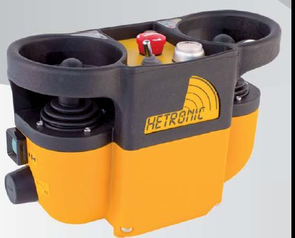
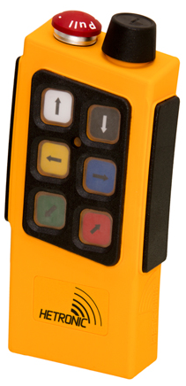
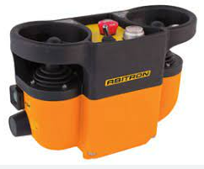
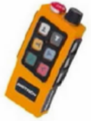
Accounting of Profits
Hetronic Int’l, Inc. v. Hetronic Germany GmbH, 99 F.4th 1150 (10th Cir. 2024)
Can a prevailing plaintiff secure the disgorgement of its opponent’s profits if those profits arose from sales by the defendant outside the United States? No.
2023 SCOTUS Decision: “to prove that a claim involves a domestic application of [the Act], plaintiffs must establish that the conduct relevant to the statute’s focus occurred in the United States.”
2024 10 Cir. Decision: "the plain focus of the Lanham Act is to punish unauthorized commercial uses of US-registered trademarks that harm American businesses and consumers by causing confusion (or a likelihood of confusion) about the true origin."
Goods Sold by the United States-Based Plaintiff
Goods Sold by the European Defendants

Slide 19


The Post Jack Daniel’s World
Punchbowl, Inc. v. AJ Press, LLC, 90 F.4th 1022 (9th Cir. 2024)
SCOTUS: Rogers is unavailable if a defendant’s use of an alleged imitation of a plaintiff’s mark is as a designation of source for the defendant’s own goods or services
On reconsideration, 9th Cir. held “It is clear from the foregoing discussion that Jack Daniel’s altered the law that governed us when we decided [the case earlier]. To the point that our precedents previously held that Rogers applies when an expressive mark is used as a mark—and that the only threshold for applying Rogers was an attempt to apply the Lanham Act to something expressive—the Supreme Court has now made clear that this is incorrect. In that specific respect, our prior precedents are no longer good law”
On remand, 9th Cir. urged district court to consider the expressive nature of the defendant’s publication
    District Court: the defendant prevailed once again as a matter of law, although less on the basis of the expressive nature of its publication and more on the lack of competitive proximity between the parties’ goods and services

Slide 20
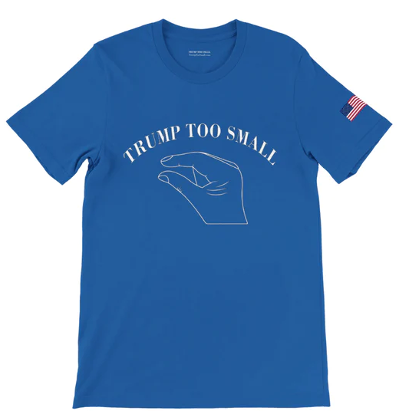
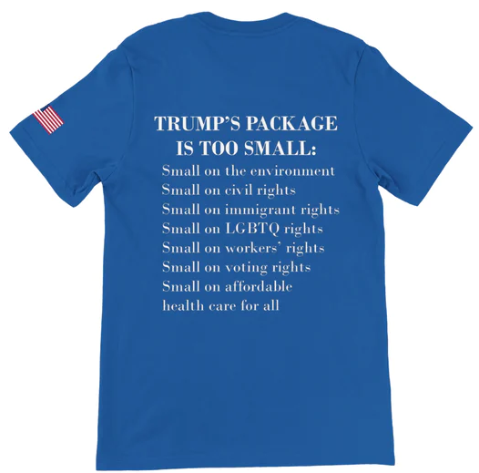
First Amendment Defense
  Vidal v. Elster, 602 U.S. 286 (2024)
Can Section 2(c) of the Lanham Act, 15 U.S.C. § 1052(c), be used to prevent the registration of politically themed marks? Yes.
No trademark by which the goods of the applicant may be distinguished from the goods of others shall be refused registration on the principal register on account of its nature unless it … [c]onsists of or comprises a name, portrait, or signature identifying a particular living individual except by his written consent, or the name, signature, or portrait of a deceased President of the United States during the life of his widow, if any, except by the written consent of the widow.

Slide 21
First Amendment Defense
  Vidal v. Elster, 602 U.S. 286 (2024)
Timeline
    The USPTO denied registration of the mark under Section 2(c) of the Act.
    Trademark Trial and Appeal Board affirms refusal.
    Fed. Circuit reverses - “[w]hatever the standard for First Amendment review of viewpoint-neutral, content-based restrictions in the trademark area, whether strict scrutiny … or intermediate scrutiny, there must be at least a substantial government interest in the restriction."
    SCOTUS grants certiorari
  SCOTUS Decision: Deep dive into trademark law history. Section 2(c)—referred to by the Court as the “names clause”—had a content-discriminatory effect, but not a viewpoint-discriminatory one.
    Held that history and tradition establish that the names clause in [Section 2(c)] does not violate the First Amendment. While an occasion may arise when “history and tradition cannot alone answer whether a trademark restriction violates the First Amendment, that occasion is not today.”

Slide 22

Nominative Fair Use
Earth, Wind & Fire IP, LLC v. Substantial Music Grp., 720 F.Supp.3d 1261 (S.D. Fla. 2024)
Test – New Kids on the Block (9th Cir.)
    the product or service in question must be one not readily identifiable without use of the trademark
    only so much of the mark or marks may be used as is reasonably necessary to identify the product or service
    the user must do nothing that would, in conjunction with the mark, suggest sponsorship or endorsement by the trademark holder

Slide 23
Questions? Comments? Reach out here:
Carrie Barbee
  Partner
  Los Angeles
310 777 3735​
cbarbee@ktslaw.com
Olivia Poppens-Schultz
Senior Associate ​
Los Angeles​
310 777 3729​
opoppens@ktlsaw.com

